Slide 1
Sales Trend Analysis Using SQL
A project on querying and analyzing sales
Joshwa Rajkumar
29-Apr-2025

Slide 2
Project Overview
Goal: Analyze sales data to extract meaningful business insights
Tools: MySQL
Dataset Used: sales table from sample database

Slide 3
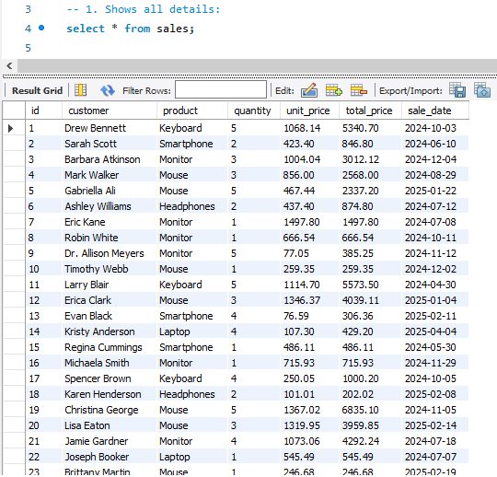
Full Data Extraction
Purpose: To inspect and understand the dataset

Slide 4
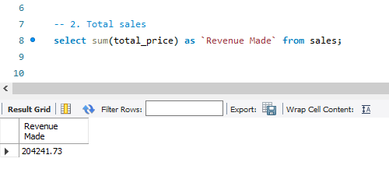
Total Revenue
Insight: Total revenue made from all sales

Slide 5
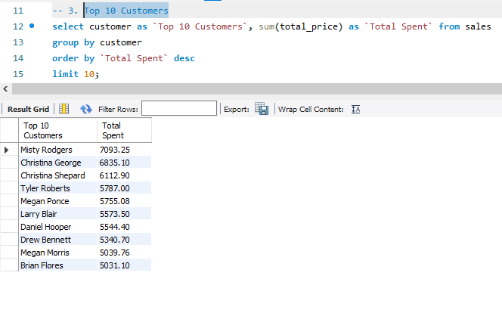
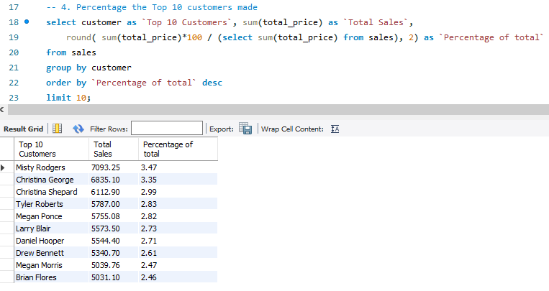
Top 10 Customers
Query Purpose: Identify biggest spenders & show what % of total revenue top 10 customers contribute
Insight:
Top 10 customers account for 29%

Slide 6
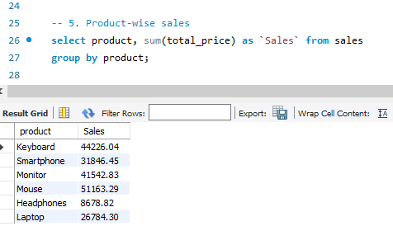
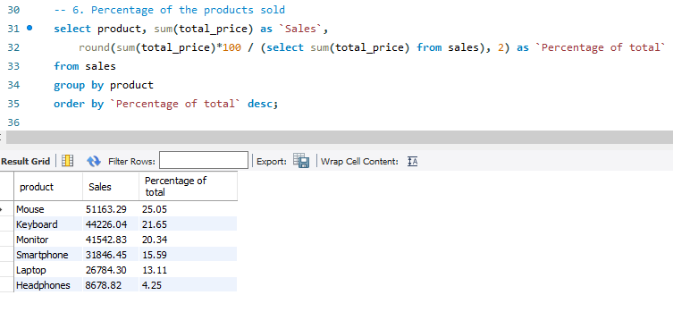
Sales by Product
Insight: Best-selling and least-selling products based on total revenue
Product-Wise Sales
Product Contribution %

Slide 7
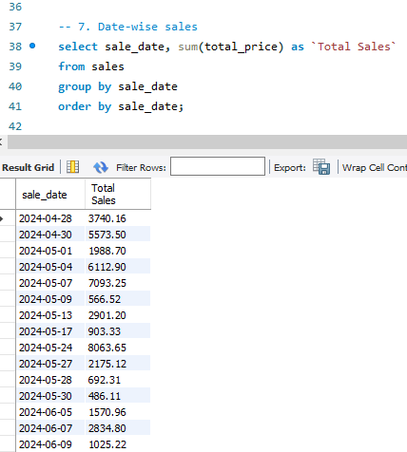
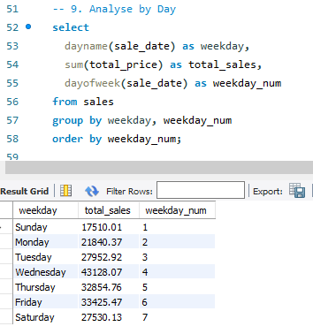
Sales by day
Query Purpose: Understand which weekdays have more sales
Insight: Most sales happen on Wednesday to Friday
Daily Sales Trend
Day of Week Analysis

Slide 8
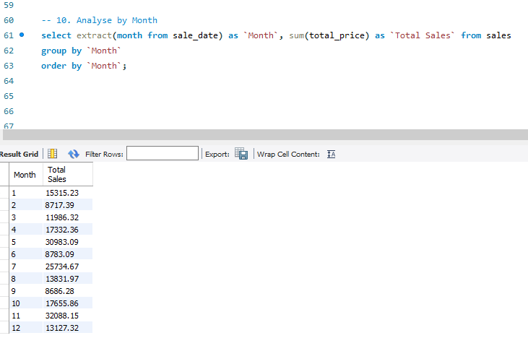
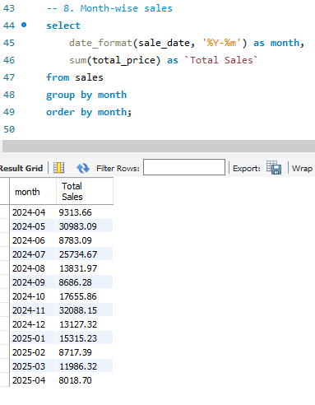
Sales by Month
Query Purpose: Compare total sales across all months
Monthly Sales Trend
Month-Wise Breakdown

